Slide 1

The Technology Value stream
Understanding Lead Time and Processing Time in DevOps
Edgar D Rosales CSD-380 DeVOps

Slide 2

Overview
The technology value stream encompasses all activities from concept to software product delivery.
It focuses on optimizing the flow of value to the customer, emphasizing efficiency and speed.

Slide 3
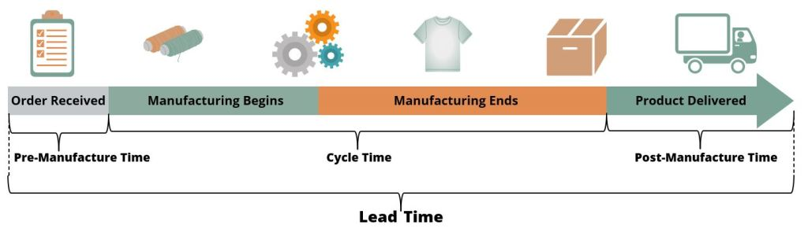
Defining Lead Time vs. Processing time
Lead Time:
The total time from when a request is made until it is fulfilled.
Includes both processing time and any waiting time.
Processing Time:
The actual time spent actively working on the task.
(shown as Cycle Time on graphic)

Slide 4
The Common Scenario: Deployment lead times Requiring Months
Explanation:
Traditional software Delivery often involves long lead times due to manual processes and siloed teams.
Challenges:
Coordination delays between departments.
Lengthy testing and approval processes.
Impact:
Slower time-to-market and reduced competitive edge.

Slide 5
Our DevOps Ideal: Deployment Lead Times of Minutes
DevOps Approach: Aims to streamline processes through automation and collaboration.
Techniques: Continuous integration (CI): Regularly merging code changes to a shared repository. Continuous Deployment (CD): Automatically deploying code changes to production.
Benefits: Rapid delivery, improved product quality, and enhanced team collaboration.

Slide 6
Strategies to Achieve DevOps Ideal
Automation: implement automated testing and deployment pipelines to reduce human error and increase speed.
Cros-functional Teams: Break down silos by integrating development, operations, and QA teams.
Feedback Loops: Use continuous feedback mechanisms to quickly adapt to changes and improve processes.

Slide 7
Conclusion
Summary:
Reducing lead times is crucial for maintaining competitive advantage
DevOps practices are essential for achieving rapid and reliable software delivery.
Future Outlook:
As technology evolves, the focus on optimizing value streams will continue to grow,

Slide 8

THANK YOU
Edgar Rosales
CSD-380 DevOps

Slide 9

Humble, J., & Farley, D. (2010). Continuous Delivery: Reliable Software Releases through Build, Test, and Deployment Automation. Addison-Wesley.
Kim, G., Humble, J., Debois, P., & Willis, J. (2016). The DevOps Handbook: How to Create World-Class Agility, Reliability, & Security in Technology Organizations. IT Revolution Press.
Forsgren, N., Humble, J., & Kim, G. (2018). Accelerate: The Science of Lean Software and DevOps: Building and Scaling High Performing Technology Organizations. IT Revolution.
REFERENCES

